Slide 1
Discussions related to two aspects on Linear Regression 1.Elasticity & Log Relationships 2. Heteroscedasticity

Slide 2
Elasticity - Introduction
We discussed Linear Regression
y = B * x + A
Multiple regression
y = B_1 * x_1 + B_2 * x_2 + … + B_n * x_n + A

Slide 3
Introduction
Linear regression, while a useful tool, has significant limits. As its name implies, it can’t easily match any data set that is non-linear
Linear regression can only be fit to data sets with a single dependent variable and a single independent variable.
y = B * x + A

Slide 4
Multiple regression
Multiple regression is a statistical technique that can be used to analyze the relationship between a single dependent variable and several independent variables.
The objective of multiple regression analysis is to use the independent variables whose values are known to predict the value of the single dependent value.
y = B_1 * x_1 + B_2 * x_2 + … + B_n * x_n + A

Slide 5
Logarithmic Transformation of the Data
Ordinary least squares estimates typically assume that the population relationship among the variables is linear.
In this form the interpretation of the coefficients is as discussed above; quite simply the coefficient provides an estimate of the impact of a one unit change in X on Y measured in units of Y.

Slide 6
The context
Context - While comparing the relationship between a number of independent variable to a dependent variable.
It may be more theoretically sound to assume that the relationship between two variables is related to percentage changes. i.e., a percentage change in X yields a b percentage change in Y, where b is the regression coefficient.
When the variables in regression are logs, the regression coefficients conform to this interpretation.
If variables are transformed to logs and are linearly related, the regression coefficients are a ratio of two percentage changes.
This is the concept of elasticity

Slide 7
Logarithmic Transformation of the Data
We are interested in the percentage impact on quantity demanded for a given percentage change in price.
Done by transforming the data to logarithms before running the regression.
The resulting coefficients will then provide a percentage change measurement of the relevant variable.

Slide 8
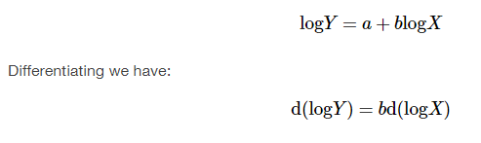
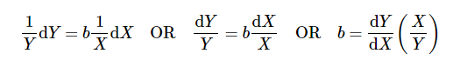
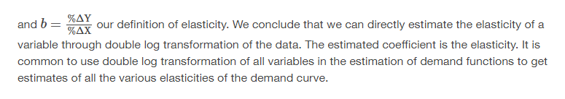
log-log case or double log case
Both the dependent and independent variables are converted to logs before the OLS estimation.
This is known as the log-log case or double log case, and provides us with direct estimates of the elasticities of the independent variables. The estimated equation is:

Slide 9
Elastic Vs Inelastic (in economics)

Slide 10
Elastic Vs Inelastic (in economics)
An elastic demand is one in which the change in quantity demanded due to a change in price is large.
An inelastic demand is one in which the change in quantity demanded due to a change in price is small.
i.e., If the formula creates an absolute value greater than 1, the demand is elastic.

Slide 11
Elasticity of Demand
The elasticity of demand, or demand elasticity, measures how demand responds to a change in price or income.
It is commonly referred to as price elasticity of demand because the price of a good or service is the most common economic factor used to measure it.

Slide 12
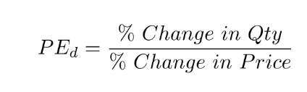
Elastic
An elastic good is defined as one where a change in price leads to a significant shift in demand and where substitutes are available for an item, the more elastic the good will be.
The price elasticity of demand is calculated by dividing the percentage change in quantity demanded by the percentage change in price.
If the quotient is greater than or equal to one, the demand is considered to be elastic. If the value is less than one, demand is considered inelastic.

Slide 13
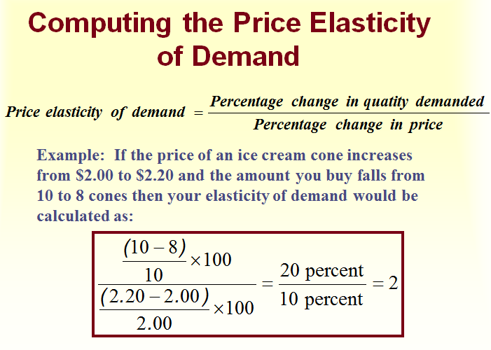

Slide 14
As applied to Demands
Elasticity of Demand
Common examples of products with high elasticity are luxury items or items easily replaced by lower-priced items (substitutes available).
Inelasticity of Demand
Inelasticity of demand is evident when demand for a good or service is static when its price or other factor changes,
Inelastic products are usually necessities without acceptable substitutes. The most common goods with inelastic demand are utilities, prescription drugs etc.
Businesses offering such products maintain greater flexibility with prices because demand remains constant even if prices increase or decrease.

Slide 15
Advantage of Using Percentages
The value of measuring in percentage terms is that the units of measurement do not play a role in the value of the measurement and thus allows direct comparison between elasticities.
As an example,
if the price of an item increased say 50 paisa from an initial price of INR 3.00 and
generated a decline in monthly consumption for a consumer from 50 units to 48 units we calculate the elasticity to be 0.25.
The price elasticity is the percentage change in quantity resulting from some percentage change in price.
A 16 percent increase in price has generated only a 4 percent decrease in demand: 16% price change → 4% quantity change or .04/.16 = .25. This is called an inelastic demand meaning a small response to the price change.
This comes about because there are few if any real substitutes for this item.
Some goods have many substitutes: pears for apples for plums, for grapes, etc. etc. The elasticity for such goods is larger than one and are called elastic in demand.
Here a small percentage change in price will induce a large percentage change in quantity demanded. The consumer will easily shift the demand to the close substitute.

Slide 16
2. Heteroscedasticity
from hetero- + scedastic, from Greek skedasis - a scattering/ dispersal
Heteroscedasticity refers to situations where the variance of the residuals is unequal over a range of measured values.
When running a regression analysis, heteroskedasticity results in an unequal scatter of the residuals (or the error term)

Slide 17
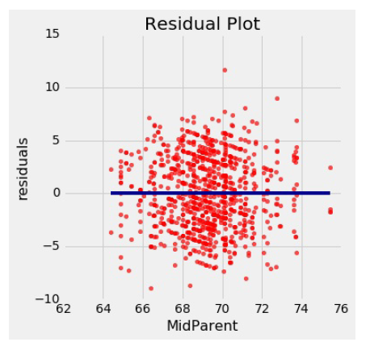
Residuals in Linear Regressions
A residual plot can be drawn by plotting the residuals against the predictor variable
Notice that the plot appears to be centered around the horizontal line at the level 0 (shown in dark blue).
Notice also that the plot shows no upward or downward trend. …. that this is true of all regressions.
The residual plot of a good regression shows no pattern.
The residuals look about the same, above and below the horizontal line at 0, across the range of the predictor variable.

Slide 18

Heteroscedasticity
A critical assumption of the classical linear regression model is that the residuals have all the same variance, σ ² .
When this condition holds, the error terms are homoscedastic, which means the errors have the same scatter regardless of the value of X.
When the scatter of the errors is different, varying depending on the value of one or more of the independent variables, the error terms are heteroscedastic.

Slide 19

Regression Model
Y_{i} = β₁ + β₂X_{i} + U_{i}
Var(U_{i}) = σ ²
Or E(U_{i}²) = σ ²
Homoscedasticity:
Var(U_{i}) = σ_{i} ²
Or E(U_{i}²) = σ_{i} ²
i =1,2,… N
Heteroscedasticity:

Slide 20

HETEROSCEDASTICITY
One of the assumptions of the classical linear regression (CLRM) is that the variance of u_{i}, the error term, is constant, or homoscedastic.
Reasons for ~:
The presence of outliers in the data
Incorrect functional form of the regression model
Incorrect transformation of data
Mixing observations with different measures of scale (such as mixing high-income households with low- income households)

Slide 21

HETEROSCEDASTICITY
Heteroscedasticity is a systematic pattern in the errors where the variances of the errors are not constant.
Heteroscedasticity occurs when the variance of the error terms differ across observations

Slide 22

Implications of ~
Heteroscedasticity implies that the variances (i.e. - the dispersion around the expected mean of zero) of the residuals are not constant, but that they are different for different observations.
This causes a problem: if the variances are unequal, then the relative reliability of each observation (used in the regression analysis) is unequal.
The larger the variance, the lower should be the importance (or weight) attached to that observation.

Slide 23

EXAMPLE
Suppose 100 students enroll in a typing class—some of which have typing experience and some of which do not.
After the first class there would be a great deal of dispersion in the number of typing mistakes.
After the final class the dispersion would be smaller .
The error variance is non constant—it falls as time increases..

Slide 24

HOMOSCEDASTIC PATTERN OF ERRORS
Consumption
Y_{i}
.
. . . . . .
.
. . . .
. . .
. . . .. . . . .
.
.
.
. .
.
. .
.
. . .
. .
. . .
X_{i}
Income

Slide 25

HETEROSCEDASTIC PATTERN OF ERRORS
Consumption
.
Y_{i}
.
.
.
.
.
.
.
.
.
.
. .
.
. . .
.
.
.
. .
.
.
.
.
. .
.
. . . . .
. . .
.
.
. . . . .
.
.
Income
X_{i}

Slide 26

CONSEQUENCES OF HETEROSCEDASTICITY
Ordinary least squares estimators not efficient.
Usual formulas give incorrect standard errors for least squares.
Confidence intervals and hypothesis tests based on usual standard errors are wrong.
If we still use OLS in the presence of heteroscedasticity, our standard errors could be inappropriate and hence any inferences we make could be misleading

Slide 27

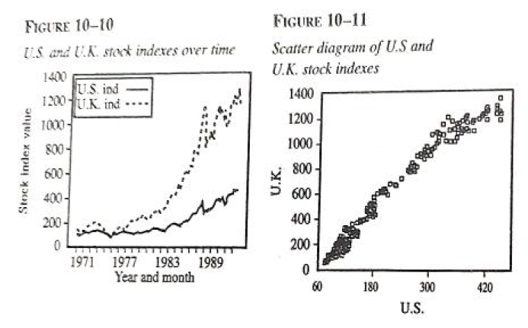
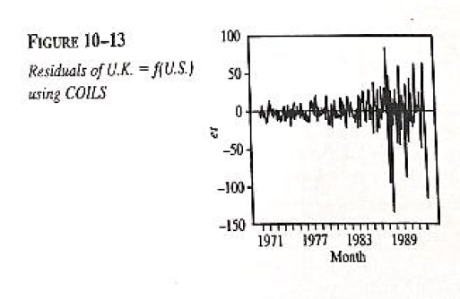
Cochrane-Orcutt Iterative LS (COILS)

Slide 28
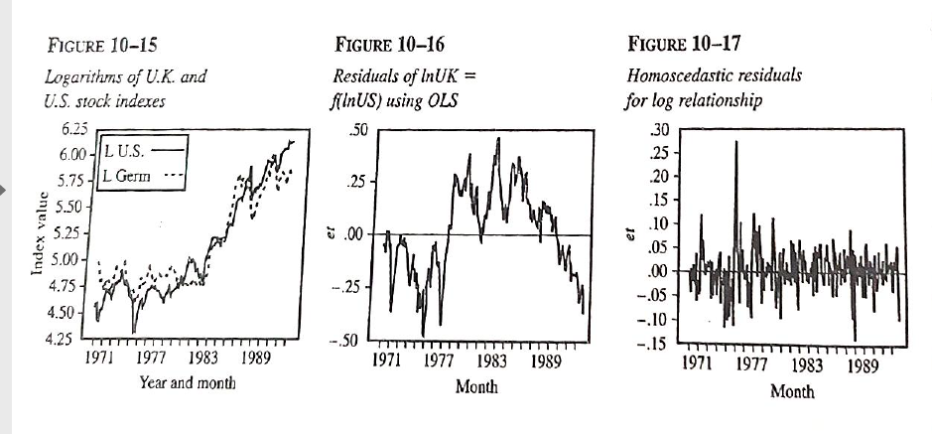
Cochrane-Orcutt Iterative LS (COILS)
Improvement in the Heteroscedasticity of residuals when log values were taken

Slide 29
CONCLUSION
One of the assumption of OLS regression is that error terms have a constant variance across all value so f independent variable
With heteroscedasticity, this error term variance is
not constant… more common in cross sectional data than time series data
Even if heteroscedasticity is present or suspected, whatever conclusions we draw or inferences we make may be very misleading.
Cochrane-Orcutt Iterative LS (COILS) is an improvement over OLS. Performs even better when variables are transformed to log-log values.

